Slide 1

Developing theoretical and experimental tools for a hybrid quantum simulation using trapped ions
Sainath Motlakunta
Quantum Information with Trapped Ions (QITI) Group

Slide 2
Talk outline
Part1: Theoretical tools: A scheme to engineer programmable spin interaction graphs in a trapped ion quantum simulator.
Part2: Experimental tools: Laser frequency stabilization for ion trap experiments

Slide 3

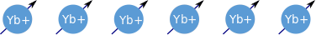
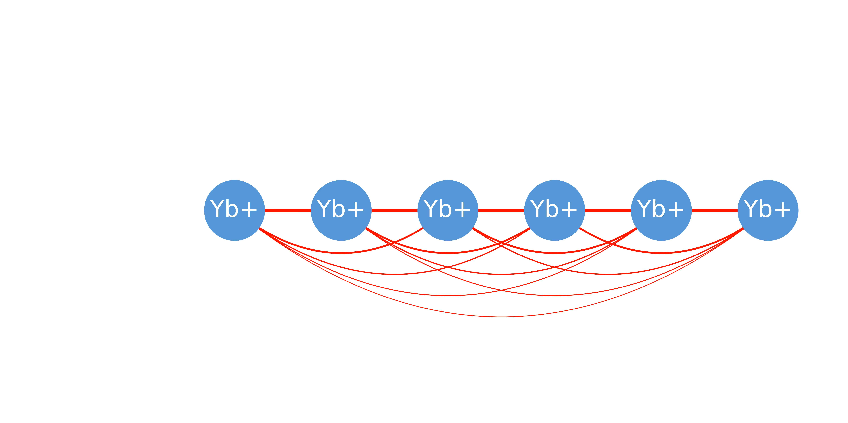

Trapped ions as Quantum Simulator
Spins
Interactions
Long coherence times (>10 min single qubit coherence time*)
Ease of state preparation and isolation
Controlled long range interactions
Flexible fully connected graphs
Useful to simulate systems with larger number of long range interactions
*Ye Wang et al Nature Photonics 11, 646–650 (2017)

Slide 4
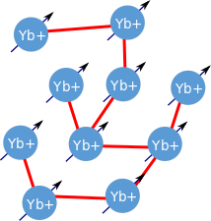
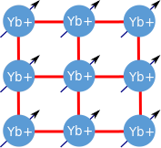
Engineer programmable spin interaction graphs
we propose a quantum simulation protocol to engineer XY spin dynamics on a 2D lattice with 1D chain of ions.

Slide 5
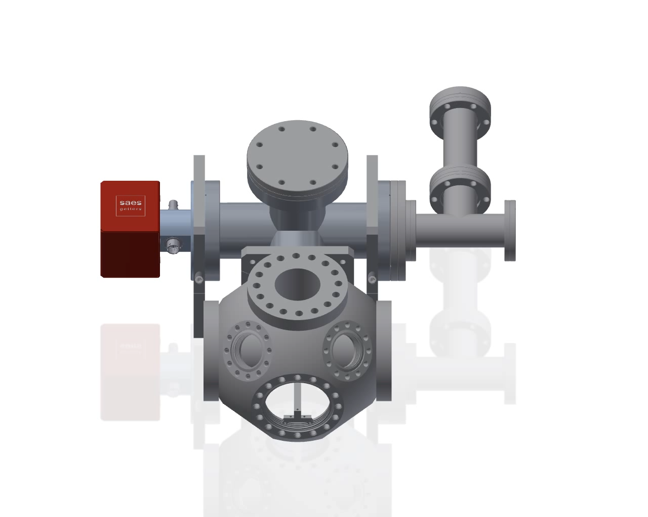
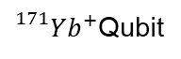
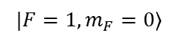
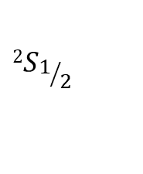
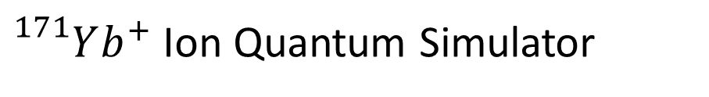
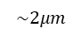
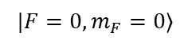
${}_{}^{171}{Yb^{+}}$ Ion Quantum Simulator
$$|F=1,m_{F}=0⟩$$
$$2S_{1/2}$$
$$|F=0,m_{F}=0⟩$$
$$\sim 2μm$$
${}_{}^{171}{Yb^{+}}$Qubit
CCD image of ions
University of Maryland/JQI
ion group

Slide 6
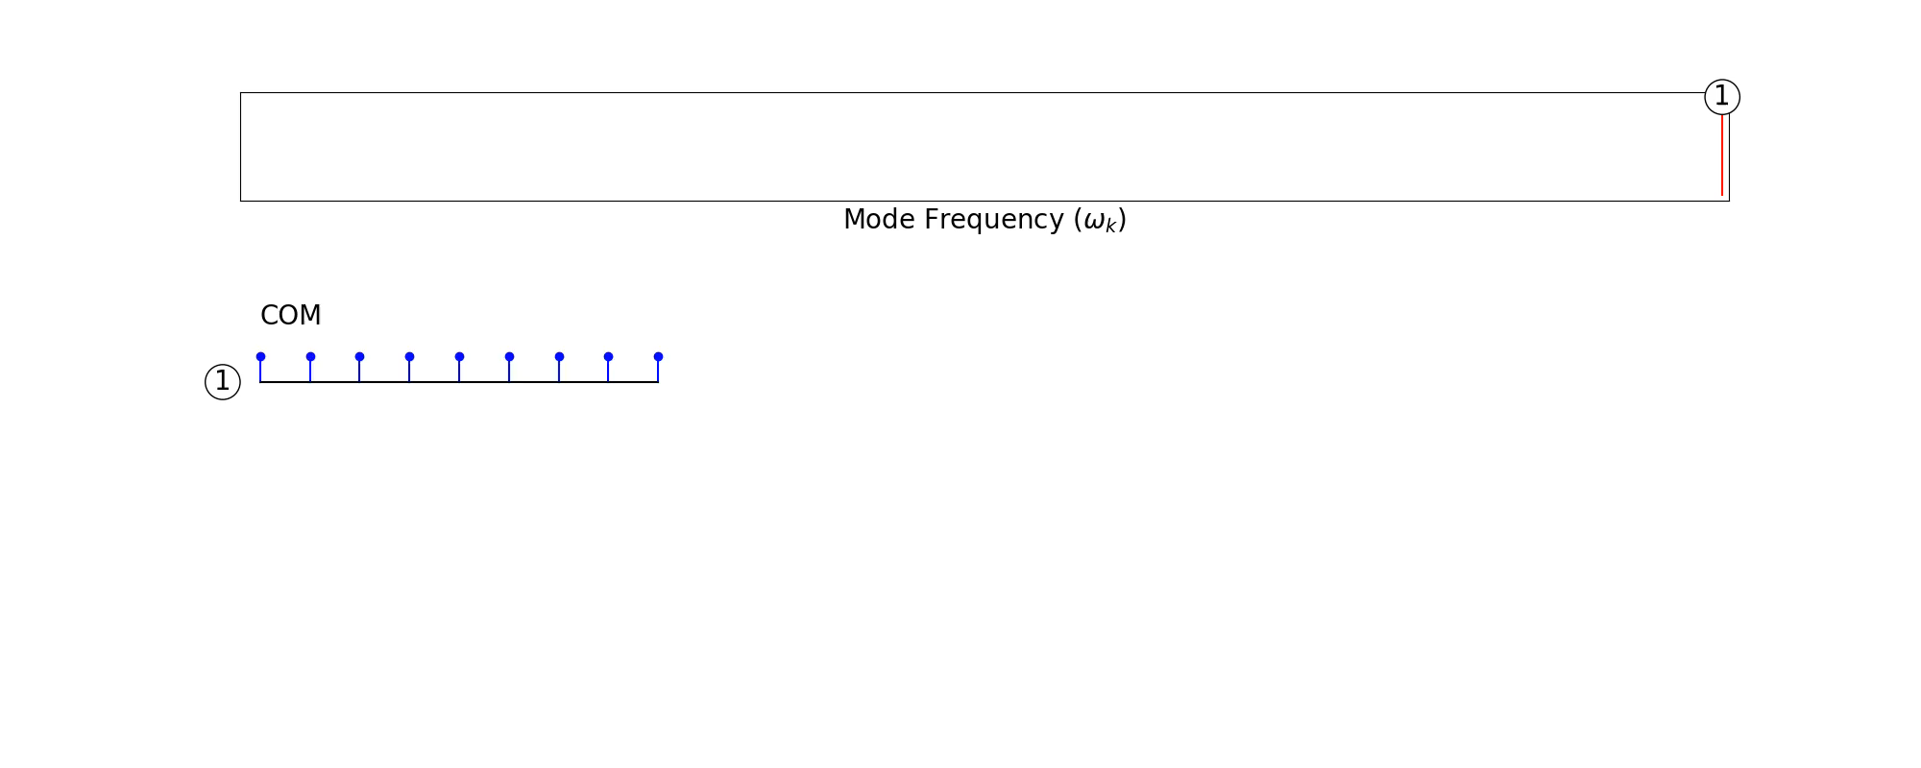
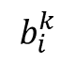
Normal modes of a chain of ions
$$b_{i}^{k}$$

Slide 7
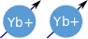
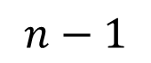
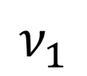
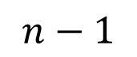
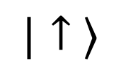
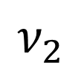


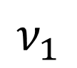
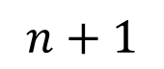
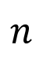
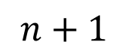
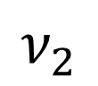
Phonon mediated spin-spin interactions
$$ν_{1}$$
$$ν_{2}$$
$$ν_{1}$$
$$n+1$$
$$n$$
$$n−1$$
$$ν_{2}$$
$$|↑ ⟩$$
$$n+1$$
$$n$$
$$n−1$$
Global laser beams
$$|↓ ⟩$$

Slide 8
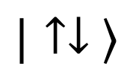
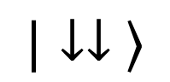
Phonon mediated spin-spin interactions
$$ν_{1}$$
$$n+1$$
$$n$$
$$n−1$$
$$ν_{2}$$
$$|↑↓ ⟩$$
$$n+1$$
$$n$$
$$n−1$$
$$|↓↓ ⟩$$

Slide 9
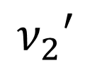
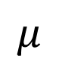
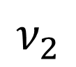
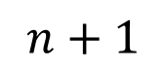
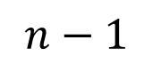
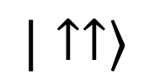

Phonon mediated spin-spin interactions
$$|↑↑⟩$$
$$n+1$$
$$ν_{1}$$
$$n$$
$$n−1$$
$$μ$$
$$n+1$$
$$n$$
$$n−1$$
$$ν_{2}$$
$$ν_{2}′$$
$$|↑↓ ⟩$$
$$n+1$$
$$n$$
$$n−1$$
$$|↓↓ ⟩$$

Slide 10
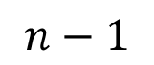

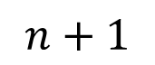
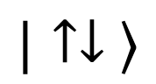
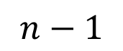

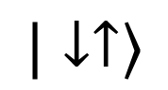
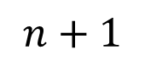
Phonon mediated spin-spin interactions
$$|↑↑⟩$$
$$|↓↑⟩$$
$$n+1$$
$$n+1$$
$$ν_{1}$$
$$n$$
$$n$$
$$n−1$$
$$n−1$$
$$ν_{2}$$
$$ν_{2}′$$
$$n+1$$
$$n+1$$
$$n$$
$$n$$
$$n−1$$
$$n−1$$
$$|↓↓ ⟩$$
$$|↑↓ ⟩$$
Cirac, Zoller PRL 4091 (1995)
Molmer, Sorensen PRL 1835 (1999)

Slide 11
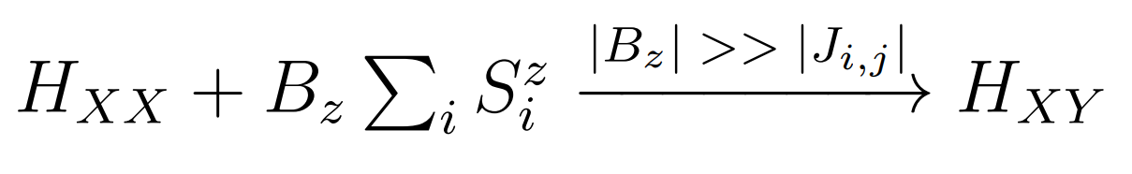
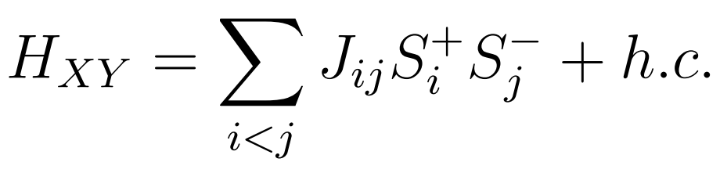
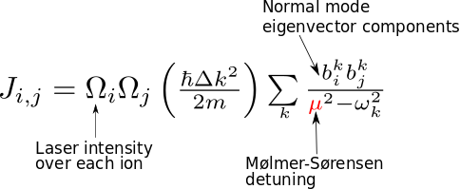
Phonon mediated spin-spin interactions
$$|↓↑⟩$$
$$n+1$$
$$ν_{1}$$
$$n$$
$$n−1$$
$$ν_{2}$$
$$ν_{2}′$$
$$n+1$$
$$n$$
$$n−1$$
$$|↑↓ ⟩$$

Slide 12
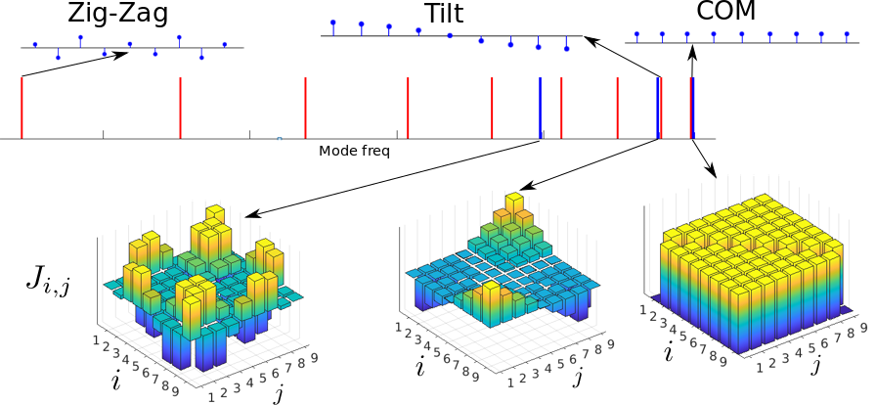
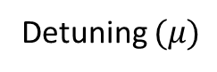
Detuning $(μ)$
Simulate various interaction profiles by changing the detuning – restricted to only certain types of profiles

Slide 13
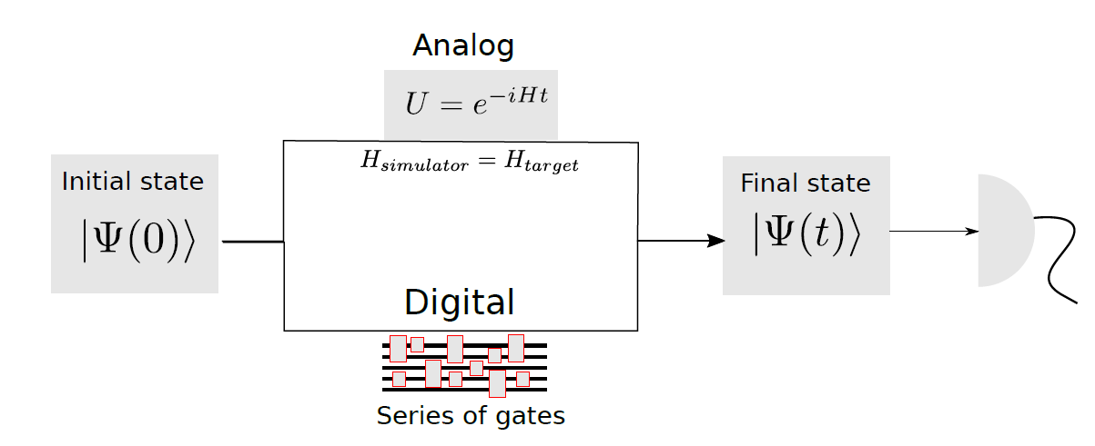
Types of Quantum simulation
Analog : Not Universal, restricted to simulation of certain types of Hamiltonians
Digital : Universal, but errors in simulation due to digitization

Slide 14
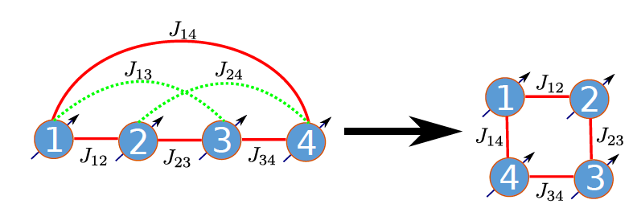
Hybrid simulation – Analog + Digital
Analog: Choose an interaction profile that can be engineered with global Raman beams. (Molmer-Sorensen scheme)
Digital: Supress unwanted interactions and scale other spin interactions by using single spin operations only
e.g., using laser induced site dependent AC stark shift

Slide 15
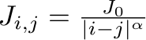
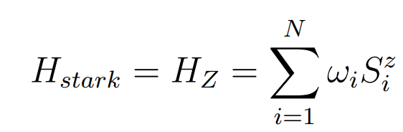
Hybrid simulation – Analog + Digital
Consider a chain of ions with internal flip-flop Hamiltonian and external AC Stark shift
Created using a global Molmer-Sorensen scheme
Created using an off-resonant laser beam with site dependent
intensity inducing a differential AC Stark shift

Slide 16
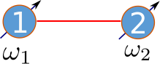
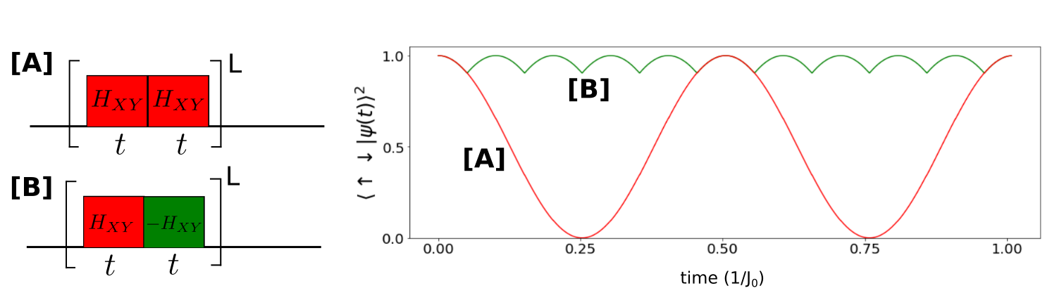
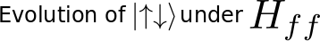

Case of 2 ions
$$J_{0}$$

Slide 17



Case of 2 ions
$$J_{0}$$

Slide 18

Goal

Slide 19






Average Hamiltonian for a sequence of pulses
Valid if
Supresses the interactions (i,j) where $ω_{ij}τ_{tot}=2nπ$

Slide 20



Task : Find a solution for $\left\{ω_{i},τ_{k},t_{k}\right\}$ to simulate 2D lattices

Slide 21




Stark shift $ω_{i}$ pattern to simulate 2D lattices
Find $ω_{i}$ such that
$$\left\{ω_{ij} \right| \left(i,j\right)∈Bond\}∩\left\{ω_{ij} \right| \left(i,j\right)∈NoBond\}=φ$$

Slide 22






Construction of pulse sequence
Fit with function
obtain optimum values of ${\{a}_{l},W\}$

Slide 23






Simulating 3x2 lattice with 6 ion chain
Bond class
NoBond class
Cancelled by $J_{ij}^{′}$

Slide 24


Slide 25



Slide 26


Slide 27



3x3 lattice with 9 ions
Fit parameters

Slide 28



4x4 lattice with 16 ions
Fit parameters

Slide 29

Scaling with the number of ions
For a target 2D square lattice

Slide 30




Extension to 3D lattice
2x2x2 lattice with 8 ions
$$α=0$$
$$=$$

Slide 31
Summary and Outlook
Hybrid quantum simulation protocol to simulate 2D lattices for the case of 6, 9, 16 ions
This protocol is scales linearly in number of pulses and stark shift gradient
Can be used to simulate different geometries of spin graphs
Explore additional control by dynamically changing Stark gradients

Slide 32
Part -2
Laser frequency stabilization

Slide 33




${}_{}^{171}{Yb^{+}}$ Ion Quantum Simulator
$$\sim 2μm$$
CCD image of ions
University of Maryland/JQI
ion group
$$|F=1,m_{F}=0⟩$$
$$2S_{1/2}$$
Long coherence times > 10 min
Ye Wang et al Nature Photonics 11, 646–650 (2017)
$$|F=0,m_{F}=0⟩$$
${}_{}^{171}{Yb^{+}}$Qubit

Slide 34
Trapped ion Quantum Simulator
TRAP
PREPARE
MANIPULATE
DETECT
Cool the ions to motional ground stata using Laser cooling
Optically pump ions to ground state
Challenge
Frequency stabilize multiple lasers
Time

Slide 35


Slide 36
Frequency stabilization of lasers
Stabilize lasers against drift due to ambient thermal and pressure fluctuations
Line width of transitions order of few MHz
No good atomic frequency reference for ions
Solutions:
Laser lock based on Commercial Wavemeter
Lock based on in-house scanning Fabry Perot cavity

Slide 37



Wavemeter lock - scheme
HighFinesse WS7 Wavemeter:
Based on Fizeau Interferometer
Range: 330 – 1100nm
Accuracy: 60 MHz
Sampling rate ~500 Hz
DL PRO
Stable reference for calibration
760nm
780nm
935nm
Home
built
369nm
8 Chn
optical
switch
FPGA
DAC Board
USB
Acquire
Transmit
Receive
PID
Ethernet
399nm
Multi Channel
Analog Voltage 0-10V

Slide 38


Analog output board
DAC7744: 4 channel 100 ksps 16bit
Numato Mimas FPGA board: Xilinx Spartan 6 LX9
Each board has 4 Analog output channels and has unique 6 bit address set by a DIP switch

Slide 39

Measurements
Pressure and temperature
measured from wavemeter

Slide 40

Measurements
DLPRO 935nm laser
Unlocked
Limited by the resolution,
accuracy and response time
Of the wavemeter
Locked

Slide 41


Cavity based frequency lock
Feedback laser to keep${ ΔT}_{369}$/${ΔT}_{780}$constant

Slide 42





Stability condition for the cavity
$$R_{1}$$
d
$$R_{2}$$
$$R_{1}=R_{2}=150mm$$
Define $g_{i}=\left(1−\frac{d}{R_{i}}\right) i=1,2$
Cavity stability condition: $0≤g_{1}∗g_{2}≤1$
We set $d \sim 100 mm FSR \sim 1.5GHz$
Kogelnik, H., & Li, T. (1966). Applied optics, 5(10), 1550-1567.

Slide 43

Cavity construction
Concave mirrors ROC=150 mm
HR Mirrors R>99.5% @ 369nm - 925nm
Expected Finesse > 600
Endcaps: Brass (360 UM) (CTE: ~20ppm/ºC )
Spacer : Quartz (CTE: ~0.5ppm/ºC)
Dimensions are chosen to minimize thermal drifts
Barry, J Ph.D. thesis, Yale University (2013).

Slide 44


Cavity mode matching

Slide 45


Cavity measurements
Lorentzian finesse ~ 400

Slide 46

Single transfer cavity to lock multiple lasers

Slide 47
Summary and Outlook
Alternate schemes for laser locking using a wavemeter and a transfer cavity
Wavemeter lock has advantages of ease and scaling, but is limited by the resolution, accuracy and the sampling rate the instrument
Cavity based lock has more resolution and sampling rate but cannot make absolute frequency measurements
Combine both the schemes to obtain the advantages of both the systems.

Slide 48
References

Slide 49








Fereshteh
Gilbert
Nikhil
Rajibul
Nikolay
Roland
Sainath
THANK YOU

Slide 50
Extra slides

Slide 51




Analog Quantum Simulation
Multi frequency extension of
Mølmer-Sørensen scheme

Slide 52


Optimize the values of to create arbitrary $J_{ij}$
One such optimized solution to simulate 2D lattices*
Requires individual ion addressability with various Mølmer-Sørensen beams
*Korenblit, S., et al. NJP 14.9 (2012): 095024

Slide 53

Experimental parameters

